Slide 1
Waiting for participants

Slide 2

Mastering Regression Models in Machine Learning
Host:
Aditya Seth
Beta MLSA

Slide 3
What will we cover today?
Understand how regression works.
Work with new algorithms: Linear regression, multiple linear regression, and polynomial regression.
Understand the strengths and limitations of regression models.
Visualize error and cost functions in linear regression.
Understand basic evaluation metrics for regression.

Slide 4
What is Regression?
Regression is a simple, common, and highly useful data analysis technique, often colloquially referred to as "fitting a line." In its simplest form, regression fits a straight line between a one variable (feature) and another (label). In more complicated forms, regression can find non-linear relationships between a single label and multiple features.

Slide 5
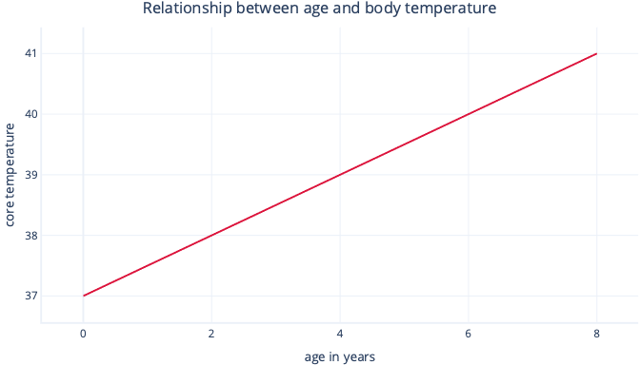

What is Simple Linear Regression ?
Simple linear regression models a linear relationship between a single feature and a usually continuous label, allowing the feature to predict the label. Visually, it might look something like this:
Simple linear regression has two parameters: an intercept (c), which indicates the value that the label is when the feature is set to zero; and a slope (m), which indicates how much the label will increase for each one-point increase in the feature.
If you like to think mathematically, this is simply:
$$y=mx+c$$
Where y is your label and x is your feature.
For example, in our scenario, if we were to try to predict which patients will have a fever-elevated body temperature-based on their age, we would have the model:
$$temperature=m∗age+c$$
And need to find the values of m and c during the fitting procedure. If we found m = 0.5 and c = 37, we might visualize it like this:
This would mean that every year of age is associated with body temperature increase of 0.5°C, with a starting point of 37°C.

Slide 6
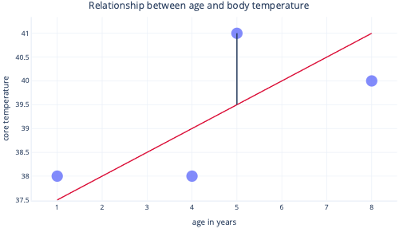
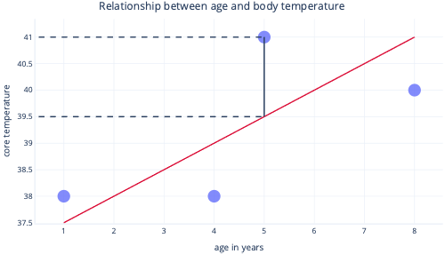
What is fitting a linear regression ?
We normally use existing libraries to fit regression models for us. Regression typically aims to find the line that produces the least amount of error, where error here means the difference between the actual data-point value and the predicted value. For example, in the following image, the black line indicates the error between the prediction, the red line, and one actual value: the dot.
By looking at these two points on a y-axis, we can see that the prediction was 39.5, but the actual value was 41.
So, the model was wrong by 1.5 for this datapoint.
Most commonly, we fit a model by minimizing the residual sum of squares. This means that the cost function is calculated like so:
1. Calculate the difference between the actual and predicted values (as previously) for each data point.
2. Square these values.
3. Sum (or average) these squared values.
This squaring step means that not all points contribute evenly to the line: outliers—which are points that don't fall in the expected pattern—have disproportionately larger error, which can influence the position of the line.

Slide 7
Strengths of Regression :
Regression techniques have many strengths that more complex models don't.
Predictable and easy to interpret
Regressions are easy to interpret because they describe simple mathematical equations, which we can often graph. More complex models are often referred to as black box solutions, because it's difficult to understand how they make predictions or how they'll behave with certain inputs.
Easy to extrapolate
Regressions make it easy to extrapolate; to make predictions for values outside the range of our dataset. For example, it's simple to estimate in our previous example that a nine year-old dog will have a temperature of 40.5°C. You should always apply caution to extrapolation: this model would predict that a 90 year-old would have a temperature nearly hot enough to boil water, xD.
Optimal fitting is usually guaranteed
Most machine learning models use gradient descent to fit models, which involves tuning the gradient descent algorithm and provides no guarantee that an optimal solution will be found. By contrast, linear regression that uses the sum of squares as a cost function doesn't actually need an iterative gradient-descent procedure. Instead, clever mathematics can be used to calculate the optimal location for the line to be placed. The mathematics are outside the scope of this module, but it's useful to know that (so long as the sample size isn't too large) linear regression doesn't need special attention to be paid to the fitting process, and the optimal solution is guaranteed.

Slide 8
Let’s jump into how to code and train a Simple Linear Regression model.
Pre-requisite: Have VS Code installed with .ipynb extension (or) GitHub Codespaces activated (or) Google Collab. Aim: Train a simple linear regression model

Slide 9
What is Multiple linear regression and R-squared?
In this unit, we'll contrast multiple linear regression with simple linear regression. We'll also look at a metric called R2, which is commonly used to evaluate the quality of a linear regression model.
Multiple linear regression models the relationship between several features and a single variable. Mathematically, it's the same as simple linear regression, and is usually fit using the same cost function, but with more features.
Rather than modeling a single relationship, this technique simultaneously models multiple relationships, which it treats as independent of one another. For example, if we're predicting how ill a dog becomes based on their age and body_fat_percentage, two relationships are found:
How age increases or decreases illness
How body_fat_percentage increases or decreases illness
If we're only working with two features, we can visualize our model as a plane—a flat 2D surface—just like we can model simple linear regression as a line. We'll explore this in the next exercise.
Multiple linear regression has assumptions
The fact that the model expects features to be independent is called a model assumption. When model assumptions aren't true, the model can make misleading predictions.
For example, age probably predicts how sick dogs become, as older dogs get more sick, along with whether dogs have been taught how to play frisbee; older dogs probably all know how to play frisbee. If we included age and knows_frisbee to our model as features, it would likely tell us knows_frisbee is a good predictor of an illness and underestimate the importance of age. This is a bit absurd, because knowing frisbee isn't likely to cause disease. By contrast, dog_breed might also be a good predictor of illness, but there's no reason to believe age predicts dog_breed, so it would be safe to include both in a model.

Slide 10
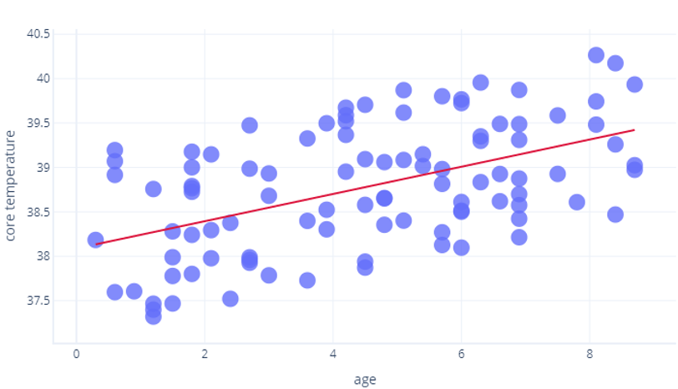
Goodness of fit: R2 metric
In this unit, we'll contrast multiple linear regression with simple linear regression. We'll also look at a metric called R2, which is commonly used to evaluate the quality of a linear regression model.
We know that cost functions can be used to assess how well a model fits the data on which it's trained. Linear regression models have a special related measure called R2 (R-squared). R2 is a value between 0 and 1 that tells us how well a linear regression model fits the data. When people talk about correlations being strong, they often mean that the R2 value was large.
R2 uses mathematics beyond what we intend to cover in this event, but we can think of it intuitively. Let's consider the previous exercise, where we looked at the relationship between age and core_temperature. An R2 of 1 would mean years could be used to perfectly predict who had a high temperature and who had a low temperature. By contrast, a 0 would mean there was simply no relationship between years and temperature.
The reality is somewhere in between. Our model could predict temperature to some degree (so it's better than R2 = 0), but points varied from this prediction somewhat (so it's less than R2=1).
R2 is only half the story.
R2 values are widely accepted, but aren't a perfect measure we can use in isolation. They suffer four limitations:
Because of how R2 is calculated, the more samples we have, the higher the R2. This can lead us to thinking that one model is better than another (identical) model, simply because R2 values were calculated using different amounts of data.
R2 values don't tell us how well a model will work with new, previously unseen data. Statisticians overcome this by calculating a supplementary measure, called a p-value, which we won't cover here. In machine learning, we often explicitly test our model on another dataset instead.
R2 values don't tell us the direction of the relationship. For example, an R2 value of 0.8 doesn't tell us whether the line is sloped upwards or downwards. It also doesn’t tell us how sloped the line is.
It's also worth keeping in mind that there’s no universal criteria for what makes an R2 value "good enough." For example, in most of physics, correlations that aren't very close to 1 are unlikely to be considered useful, but when modeling complex systems, R2 values as low as 0.3 might be considered to be excellent.

Slide 11
Let’s jump into how to code and train a Multiple Linear Regression model.
Pre-requisite: Have VS Code installed with .ipynb extension (or) GitHub Codespaces activated (or) Google Collab. Aim: Train a multiple linear regression model

Slide 12
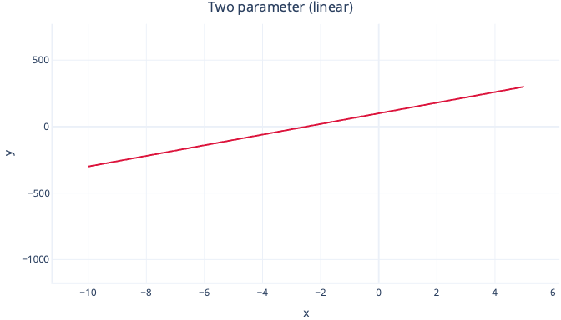
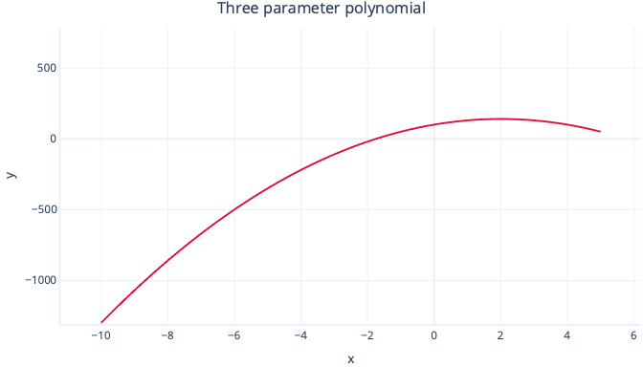
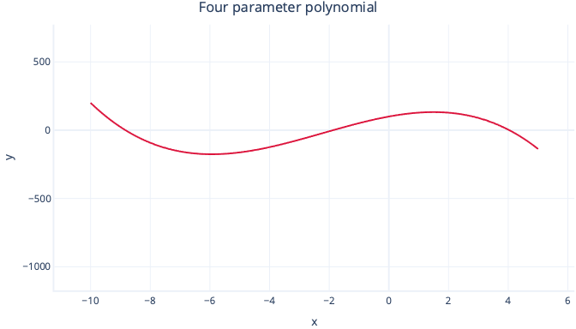
What is Polynomial Regression?
Polynomial regression models relationships as a particular type of curve. Polynomials are a family of curves, ranging from simple to complex shapes. The more parameters in the equation (model), the more complex the curve can be.
For example, a two-parameter polynomial is simply a straight line:
y = intercept + B1*x
While a three-parameter polynomial has a single bend in it:
y = intercept + B1*x + B2 * x2
And a four-parameter polynomial can have two bends:
y = intercept + B1*x + B2 * x2 + B3 * x3

Slide 13
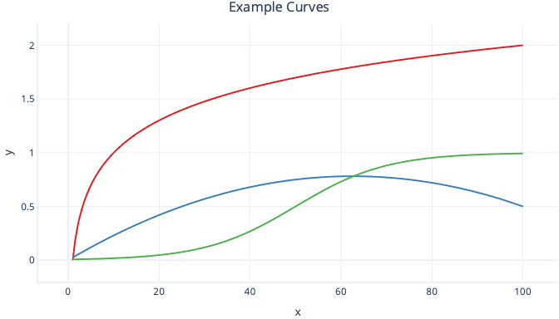
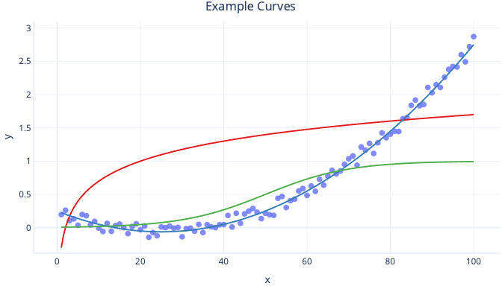
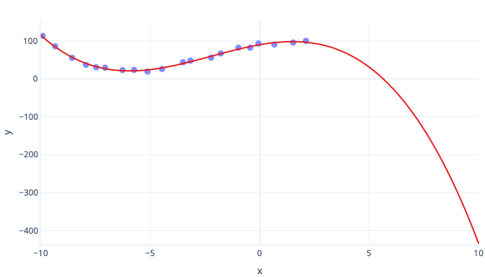
Polynomial versus other curves
There are many kinds of curves, such as log curves and logistic (s-shaped) curves, all of which can be used with regression.
A major advantage of polynomial regression is that you can use it to look at all sorts of relationships. For example, you can use polynomial regression for relationships that are negative within a certain range of feature values, but positive within others. You can also use it where the label (y value) has no theoretical upper limit.
The major disadvantage to polynomial curves is that they often extrapolate poorly. In other words, if we try to predict values that are larger or smaller than our training data, polynomials can predict unrealistically extreme values. Another disadvantage is that polynomial curves are easy to overfit. This means that noise in the data can change the shape of the curve much more than simpler models, such as simple linear regression.

Slide 14
Let’s jump into how to code and fit a Simple Polynomial Regression model.
Can curves be used with multiple features?
We've seen how multiple regression can fit several linear relationships at the same time. There's no need for these to be limited to linear relationships, though. Curves of all kinds can be used for these relationships where appropriate. Although you should take care not to use curves such as polynomials with multiple features where they're not necessary. This is because the relationships can end up very complex, which makes it harder to understand the models and assess whether they'll make predictions that don't make sense from a real-world standpoint.
Pre-requisite: Have VS Code installed with .ipynb extension (or) GitHub Codespaces activated (or) Google Collab.
Aim: Fitting a Polynomial Curve in Simple Linear Regression and extrapolating data.

Slide 15

TIME FOR QUIZ

Slide 16
Quiz link / QR Code
https://quiz.konfhub.com/q/regressionkraze-1

Slide 17
QnA Session

Slide 18
Thank You! Aditya Seth.
Hope you enjoyed :D

